Slide 1
P.D. – Turnkey of Digital Tools for Collaboration and Student Engagement
Laura Bennett

Slide 2
Please go to my website!
Msbennettmhvp.weebly.com
On the left-hand side, hover over where it says, “Teachers,” go to the right and click “MHVP Best Practices”

Slide 3
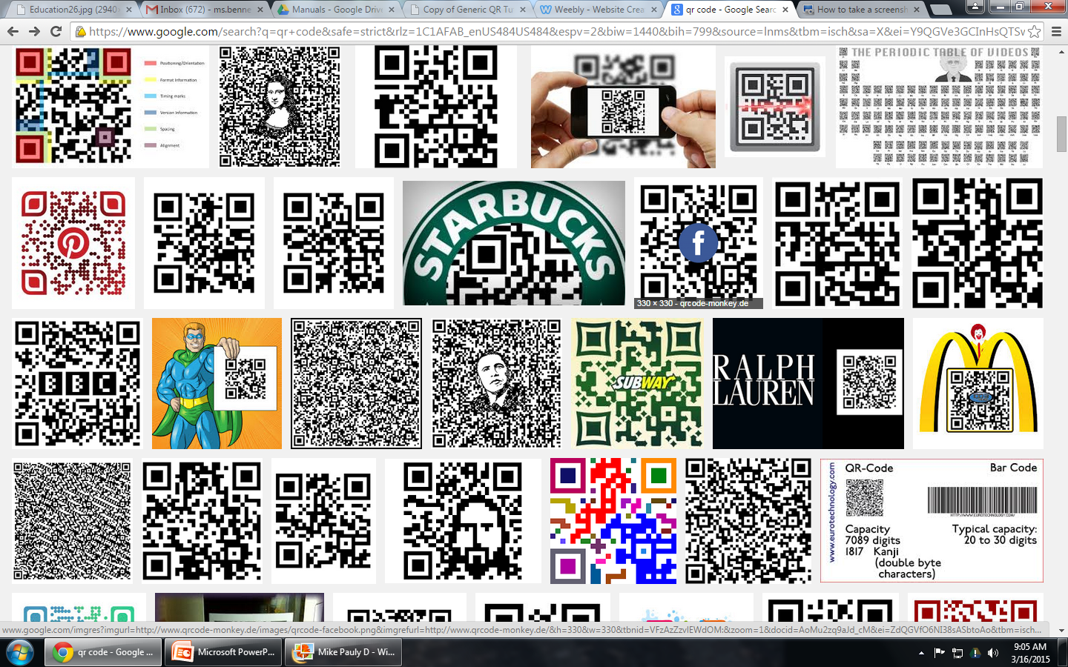
Skill #1: QR Codes
Ever seen one of these and had no idea what it was?!

Slide 4
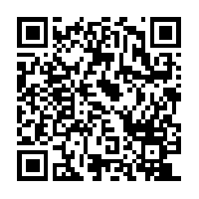
Step 1:
On your phone or tablet, download a Q.R. reader if you do not have one already.
Scan the code below. (or click on link)
http://www.komonews.com/news/entertainment/Hes-not-Pauly-D-But-dont-tell-them-that-161716785.html

Slide 5
How do I use this in my classroom?
Go to my website, and under “P.D. Monday, March 15^{th,}” Download file under “How I Used This in My Classroom.”
Scan the first code and take the survey
Always important to have a back-up- many students eventually switched to laptops

Slide 6
Step 2: Create Your Own Q.R. Code!
Think of a website that you use in your classroom.
Go to qrstuff.com
Copy and paste link, and download the code and save it

Slide 7
The End!

