Slide 1
P.D. – Turnkey of Digital Tools for Collaboration and Student Engagement- March 23rd
Laura Bennett

Slide 2
Please go to my website!
Msbennettmhvp.weebly.com
On the left-hand side, hover over where it says, “MHVP P.D.,” and go to the right and click “PD March 24th”
Download Powerpoint (if you would like but not necessary)

Slide 3
Skill #1: Google Forms
Similar to
Survey Monkey
How do I use
this in my classroom?
-Pre-test
-Check for
Understanding
-Quiz

Slide 4
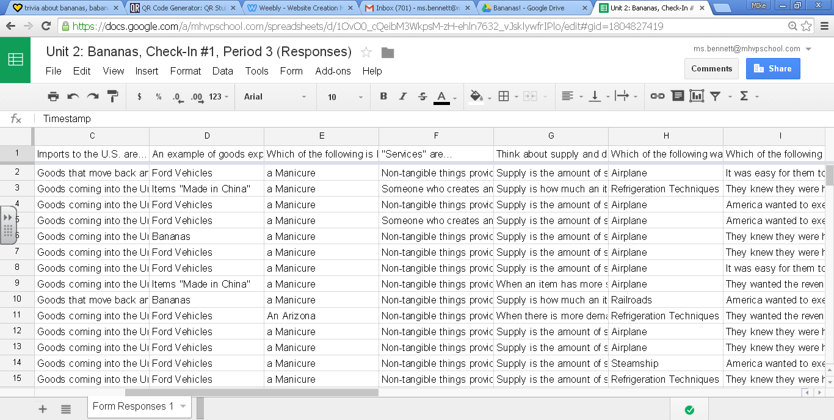
What are the benefits??
Track responses to questions (either anonymously, or by name)

Slide 5
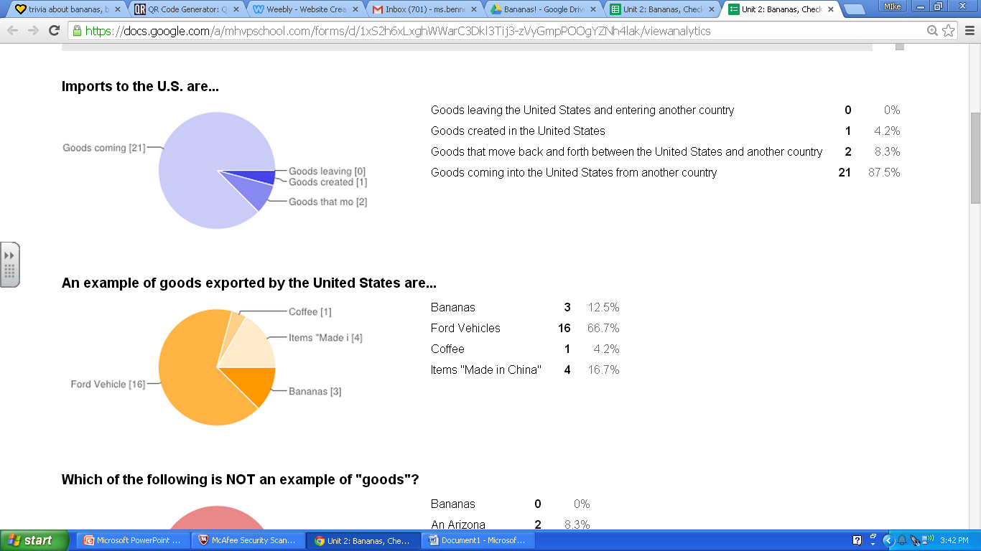
Click “Form,” “Show Summary of Responses”
Breaks down responses in Pie Charts and totals in real time

Slide 6
Skill #2: Flubaroo
Anyone ever heard of it?!

Slide 7
What are the benefits?
Will grade the assignment
Targets difficult questions

Slide 8
Let’s Make Our Own Form! Step 1:
Log-in to your mhvp email or another gmail account
Select “Drive”
On the left-hand side, select “New” and scroll down to “More” and select “Google Forms.”

Slide 9
Step 2: Create Your Own Google Form!
Think of a website that you use in your classroom.
Go to qrstuff.com
Copy and paste link, and download the code and save it

Slide 10
How do I see the finished copy?
Click “View Live Form”
This is the link you will use to provide others or make a QR Code

Slide 11
How do I see the Responses?
Automatically, a response form should have been created for you to view in your google drive.

Slide 12
How do I Add Flubaroo?
While Viewing the responses, go to “Add On” and select “Get Add Ons” and then Flubaroo.
To have Flubaroo grade your assignment, you select “Add-Ons,” “Enable Flubaroo.”
Go back under “Add-Ons” again and select Flubaroo, then “Grade Assignment.” (You will first need to take the survey yourself so that you can make it the key, and have responses from students).

Slide 13
The End!

